Slide 1
CS174A Lecture 4

Slide 2
SIGGRAPH trailers from 2016
Going backwards,
https://www.youtube.com/watch?v=l1KO-lnHfps
And
https://www.youtube.com/watch?v=dQBJ0r5Pj5s

Slide 3
Today on https://www.dwitter.net/
Today on https://www.shadertoy.com/slideshow

Slide 4
Announcements & Reminders
1/21/24: A1 due by Sunday midnight
2/04/24: A2 due; will be discussed during this week’s TA session
2/08/24: Midterm Exam: 6:00-7:30 PM PST, in person, in class
Start forming your project teams (team size: 2-4)
2/28/24: initial project proposals & teams due
3/13/24: final proposals due

Slide 5
Last Lecture Recap
Primitives: points, vectors
Vectors: dot and cross products
Coordinate Systems: LH CS, RH CS
Matrices: square, zero, identity, symmetric, matrix operations, matrix properties

Slide 6
Next Up
Team Project Intro
Homogeneous Representation of Points & Vectors
Spaces: Vector & Affine
Shapes: lines, circles, polygons (triangles), polyhedrons
Transformations: translation, scaling, rotation, shear
Spaces:
Model space
Object/world space
Eye/camera space
Screen space

Slide 7
Points vs Vectors
What is the difference?
Points have location, but no size or direction or shape
Vectors have size and direction, but no location or shape
Problem: We represent 3D points/vectors both as 3-tuples

Slide 8
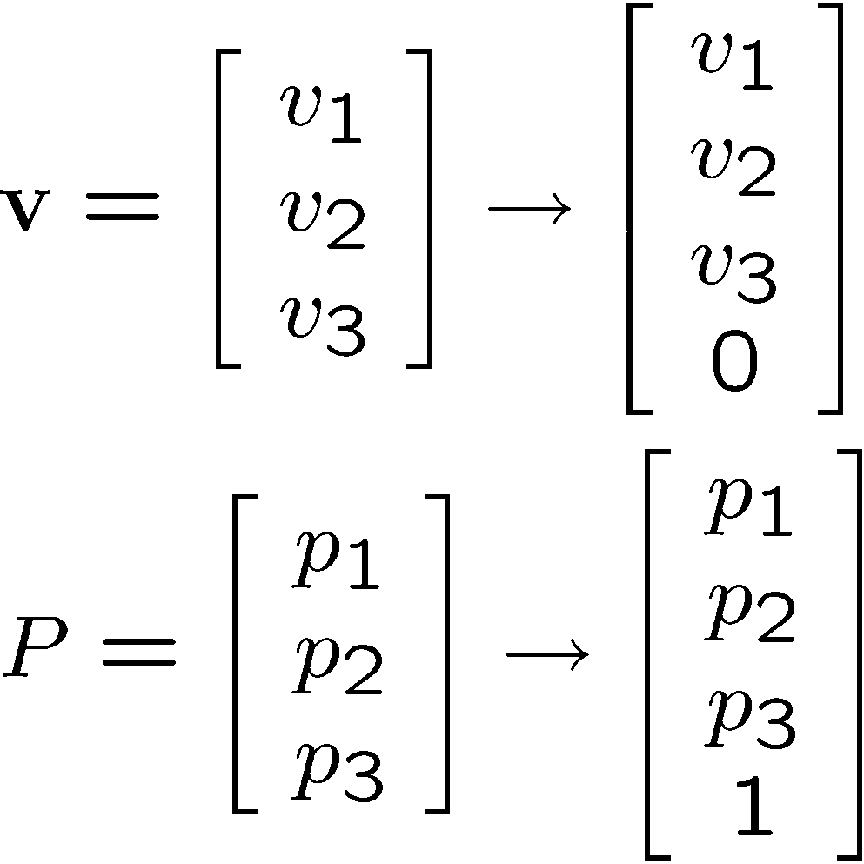
Homogeneous Representation
Convention: 3D-Vectors and 3D-Points are represented as 4x1 column matrices, as follows:

Slide 9
Switching Representations
Normal to homogeneous:
Vector: append as fourth coordinate 0
Point: append as fourth coordinate 1

Slide 10
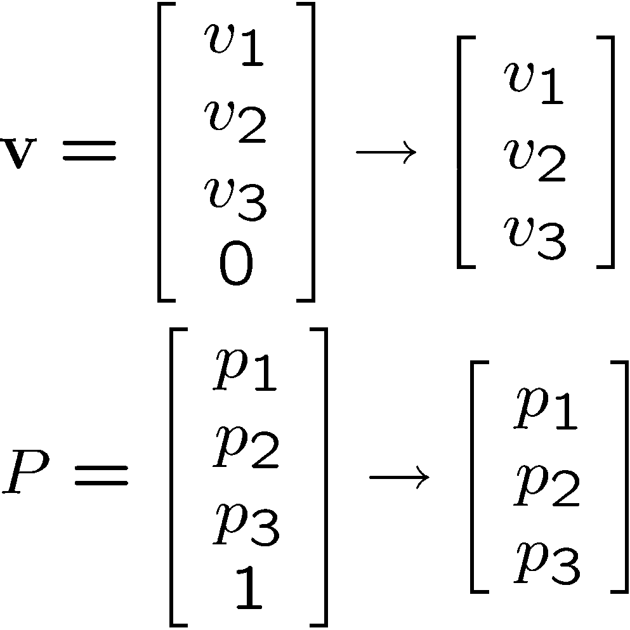
Switching Representations
Homogeneous to normal:
Vector: remove fourth coordinate (0)
Point: remove fourth coordinate (1)

Slide 11
Relationship Between Points and Vectors
A difference between two points is a vector:
Q – P = v
We can consider a point as a base point plus a vector offset:
Q = P + v
Q
P
v

Slide 12
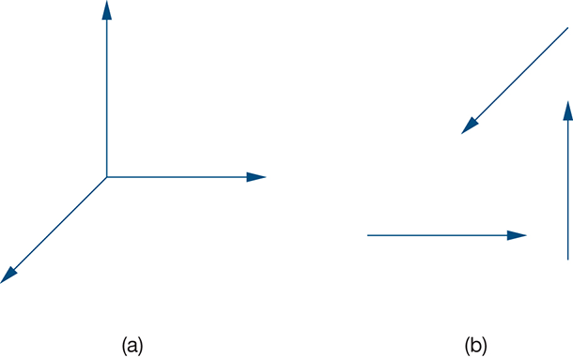
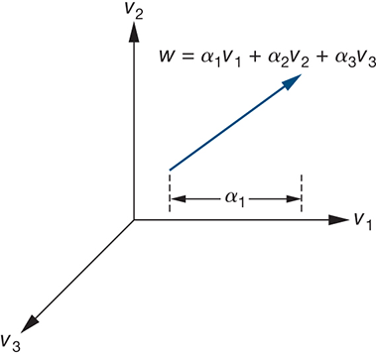

Spaces & Frames
Vector & Affine Spaces
Basis = Vector Space: support only vectors, not points
Frame = Basis + PoR (origin) = Affine Space: support vectors & points
Basis defined by v₁,v₂,v₃; Frame defined by v₁,v₂,v₃,P₀

Slide 13
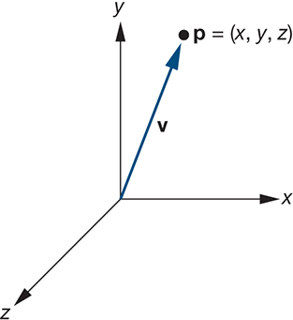
Coordinate System
Vectors & Points
w = α₁v₁ + α₂v₂ + α₃v₃
v = P – P₀
P = P₀ + v = P₀ + α₁v₁ + α₂v₂ + α₃v₃

Slide 14
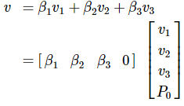
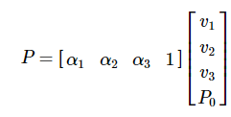
Homogeneous Representation
Vectors & Points
v = β₁v₁ + β₂v₂ + β₃v₃
P = P₀ + v = P₀ + α₁v₁ + α₂v₂ + α₃v₃

Slide 15
Does the Homogeneous Representation Support Operations?
Operations :
v + w = [v₁,v₂,v₃,0]^{T} + [w₁,w₂,w₃,0]^{T} = [v₁ + w₁, v₂ + w₂, v₃ + w₃, 0]^{T} Vector
av = a[v₁,v₂,v₃,0]^{T} = [av₁, av₂, av₃, 0]^{T} Vector
av + bw = a[v₁,v₂,v₃,0]^{T} + b[w₁,w₂,w₃,0]^{T} = [av₁ + bw₁, av₂ + bw₂, av₃ + bw₃, 0]^{T} Vector
P + v = [p₁, p₂, p₃, 1]^{T} + [v₁, v₂, v₃, 0]^{T} = [p₁ + v₁, p₂ + v₂, p₃ + v₃, 1]^{T} Point
P – Q = [p₁,p₂,p₃,1]^{T} – [q₁,q₂,q₃,1]^{T} = [p₁ – q₁, p₂ – q₂, p₃ – q₃, 0]^{T} Vector

Slide 16
Linear Combination of Points
Points P, Q scalars a, b:
aP + bQ = a [p₁, p₂, p₃,1]^{T} + b[q₁, q₂, q₃,1]^{T} = [ap₁+bq₁, ap₂+bq₂, ap₃+bq₃, a+b]^{T}
What is this?

Slide 17
Linear Combination of Points
Points P, Q scalars a, b:
aP + bQ = a [p₁, p₂, p₃,1]^{T} + b[q₁, q₂, q₃,1]^{T} = [ap₁+bq₁, ap₂+bq₂, ap₃+bq₃, a+b]^{T}
What is it?
If (a + b) = 0 then vector!
If (a + b) = 1 then point!
Otherwise, ??

Slide 18
Affine Combinations of Points
Definition:
n points P_{i}: i = 1,…,n
n scalars a_{i}: i = 1,…,n
a₁P₁+ … + a_{n}P_{n} iff a₁+ …+a_{n} = 1
Example (n = 2): 0.5P₁ + 0.5P₂
Example (n = 2): (1-s)P₁ + sP₂
Example (n = 3): (1-s-t)P₁ + sP₂ + tP₃

Slide 19
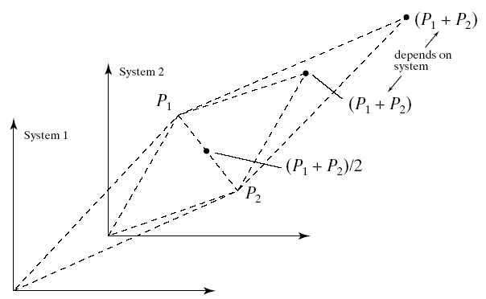
Geometric Interpretation

Slide 20
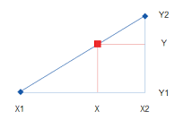
Exercise:
List some points along a line from one point to another - This process is called convex interpolation

Slide 21
Linear interpolation (2 points)
The formula to do that is quite short:
p_{interpolated} = (1-a) * p₁ + a * p₂
It’s only an interpolation (and called “convex”) if 0<=a<=1
Otherwise it's an extrapolation
You’ll be seeing that equation a lot

Slide 22
Linear interpolation (2 points)
The formula to do that is quite short:
p_{interpolated} = (1-a) * p₁ + a * p₂
Let (a) vary from 0 to 1 in steps - this is a parametric equation.
Or we could imagine a parameter time (t) rather than (a) -- at each time t between 0 sec and 1 sec we reach a different point on the line segment. Now it’s animated.

Slide 23
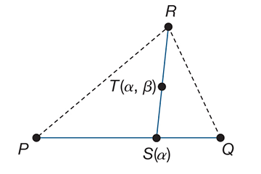
Linear interpolation (3 points = plane)
Interpolation between 3 points
S(a) = (1-a) * P + a * Q
T(a,b) = (1-b) * S + b * R
T(a,b) = (1-b) * [(1-a) * P + a * Q] + b * R

Slide 24
Making Shapes in Code
Computer graphics in practice

Slide 25
Summary
Modeling
Discretizing shapes (Vertices)
Geometry
Data structures
Indexing

Slide 26
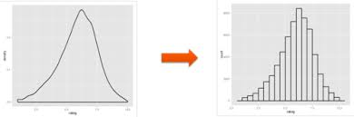
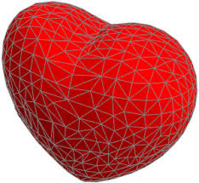
Discretization
We don't know how to tell a computer to draw most shapes because of their complicated non-linear formulas.
Instead, we linearize those shapes: Break them up into a finite number of line segments between N discrete points
Piecewise planar shapes:

Slide 27
Polygon
Collection of points connected with lines
Vertices: v₁,v₂,v₃,v₄
Edges: e₁ = v₁v₂ e₂ = v₂v₃ e₃ = v₃v₄ e₄ = v₄v₁
v₁
v₂
v₄
v₃

Slide 28
Polygons
Closed / open
Wireframe / filled
Planar / non-planar
Convex / concave
Simple / non-simple

Slide 29
Triangles
The most common primitive
Simple
Convex
Planar

Slide 30
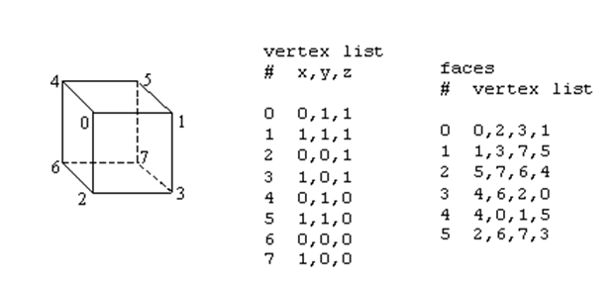
Polygonal Models / Data Structures
Indexed face set

Slide 31
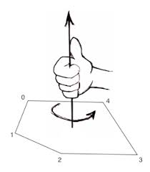
Polygonal Models / Data Structures
Face Normal

Slide 32
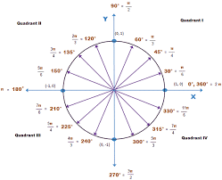
Let's list N points around a circle.
First point: (1,0,0)

Slide 33
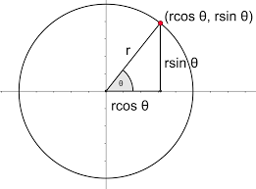
Let's list N points around a circle.
x = r*cos(Θ), y = r*sin(Θ) where theta is as shown below.
Using Θ as a variable input parameter, take N tiny steps from 0...2*PI.

Slide 34
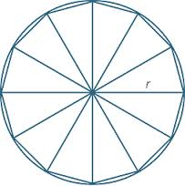
Triangles
We want to draw the whole 2D area, not just some points
Simplest 2d shape (remove any points and it will make it 1d) - this makes triangles the "2D simplex"

Slide 35
Triangles
List the points in triangle order - two approaches:
Sort list into triples of points
(0,0), (1,0),(0.479, 0.878), (0,0), (0.479, 0.878), (0.841,0.540)...
Repeats are evident here
Or, make a separate list of sorted triples of indices
Indices are shorter to write, so more triangles can fit in a CPU cache:
0,1,2,0,2,3,0,3,4,0,4,5,0,5,6,0,6,7...

